Slide 1
sentiment analysis
CAPSTONE PROJECT
Presented By:
1. MALLADI NARENDRA-NRI Institute Of Technology-Information Technology

Slide 2
OUTLINE
Problem Statement
Proposed System/Solution
System Development Approach
Algorithm & Deployment
Result
Conclusion
Future Scope
References

Slide 3
Problem Statement
Develop a sentiment analysis model to classify reviews as positive or negative of a Restaurant.

Slide 4
Proposed Solution
The proposed system aims to address the challenge of Develop a sentiment analysis model to classify reviews as positive or negative of a Restaurant. This involves leveraging machine learning techniques to forecast demand patterns accurately. The solution will consist of the following components:
Data Collection:
Load the Dataset: Load the CSV file (reviews.csv) containing two columns: "Review" (text data) and "Liked" (binary labels).
Handle Missing Data: Check for any missing values in both columns and handle them appropriately (remove rows with missing values or impute if necessary).
Data Preprocessing:
Tokenization: Split each review text into individual words or tokens.
Lowercasing: Convert all text to lowercase to ensure consistency (e.g., 'Good' and 'good' should be treated the same).
Remove Punctuation and Special Characters: Strip out non-alphabetic characters since they usually don't contribute to sentiment analysis.
Stopwords Removal: Remove common stopwords (like 'and', 'the', 'is') that do not carry significant sentiment.
Stemming or Lemmatization: Reduce words to their root form to normalize the text data (e.g., converting 'running', 'ran', 'runs' to 'run').
Machine Learning Algorithm:
Implement a machine learning algorithm, such as Naive Bayes Classifier is used to Fast to train and predict, works well with high-dimensional data like text.
Deployment:
Deploy the model in to classify new restaurant reviews into positive or negative sentiments.
Develop a RESTful API using frameworks like Flask or FastAPI to expose the sentiment analysis model for inference.
Evaluation:
Evaluate the trained model's performance on the test set using metrics such as accuracy, precision, recall, and F1-score.
Adjust parameters or try different models to improve performance if necessary.

Slide 5
System Approach
To perform Sentiment analysis on the dataset 'Reviews.csv' and analyze customer behavior,
preferences, and satisfaction levels, you will need to set up a Python environment with the necessary libraries installed. Here are the system requirements and library requirements:
system requirements:
1.Hardware:
-A computer with sufficient processing power, and A multi-core processor is recommended to handle computations
efficiently, especially for large datasets. -Adequate RAM to handle the size of the dataset and computational requirements.
2.software:
The choice of operating system is flexible, as Python and necessary libraries are available on major platforms
including Windows, macOS, and Linux

Slide 6
System Approach-CONT-
library requirements:
-nltk
-seaborn
-pandas
-matplotlib
-Scikit-learn.

Slide 7
Algorithm & Deployment
In the Algorithm section, describe the machine learning algorithm chosen for analysis reviews as positive or negative. Here's an example structure for this section:
Algorithm Selection:
Naive Bayes classifiers are selected due to their effectiveness in text classification tasks like sentiment analysis. They leverage Bayes' theorem with an assumption of independence between features (words in this case), making them computationally efficient and straightforward to implement..
Pre Processing:
Clean and preprocess the reviews.csv dataset by removing stopwords, punctuation, and performing tokenization,stemming and lematization.
Training Process:
Train the Naive Bayes classifier on a labeled dataset consisting of reviews (Review column) and corresponding sentiment labels (Liked column).
Prediction Process:
Evaluate the classifier using metrics such as accuracy, precision, recall, and F1-score to assess its effectiveness in sentiment classification.

Slide 8
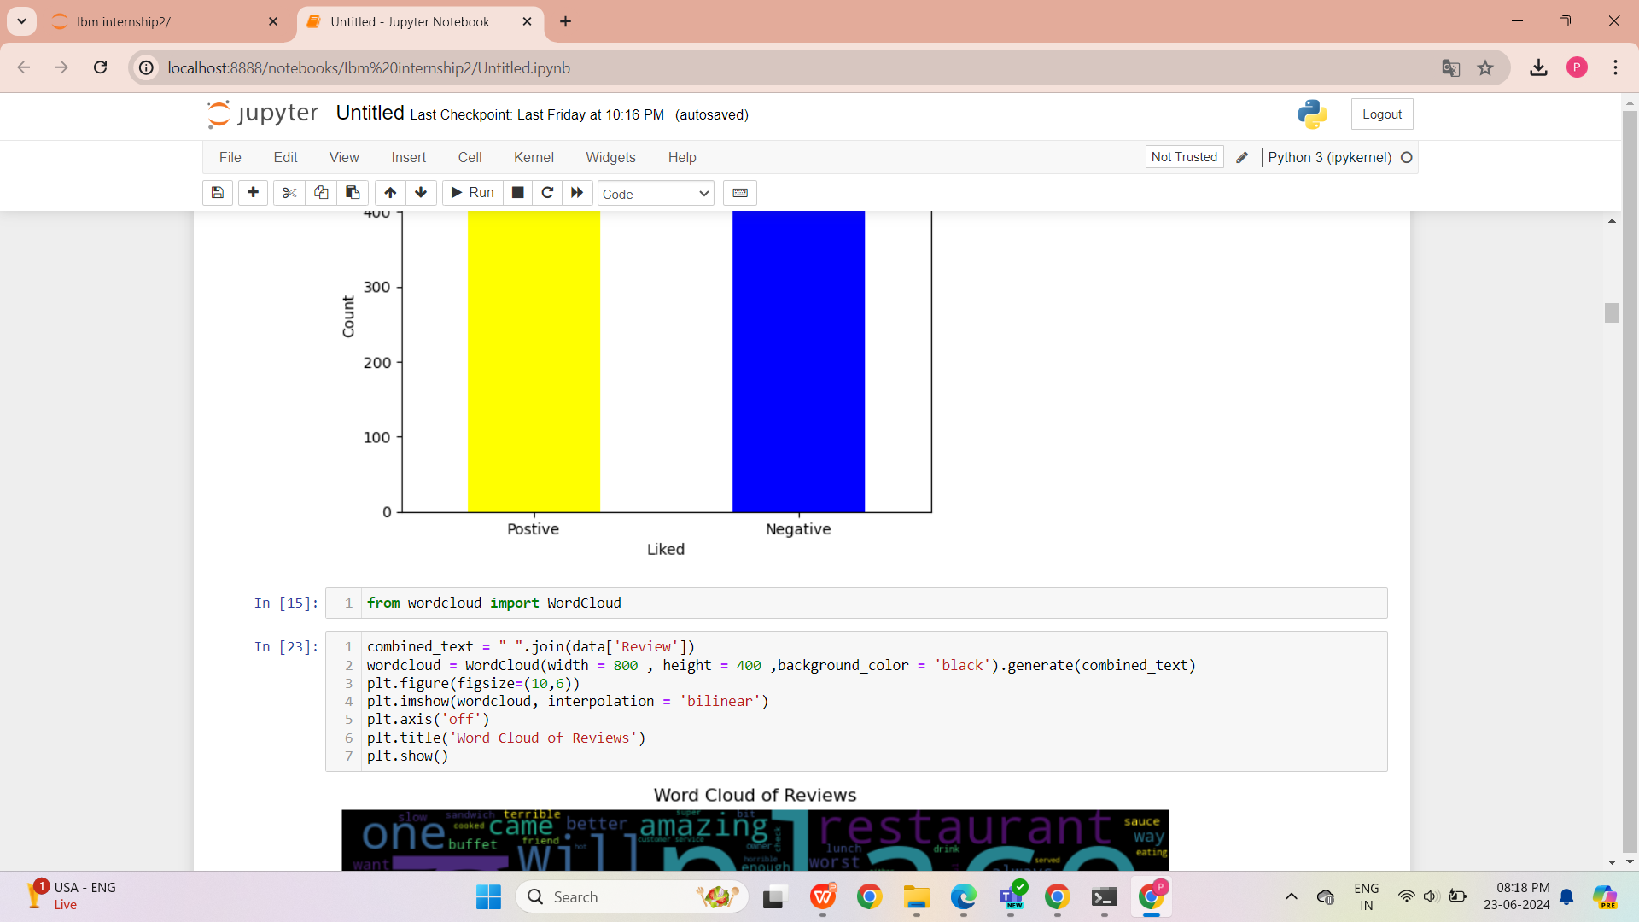
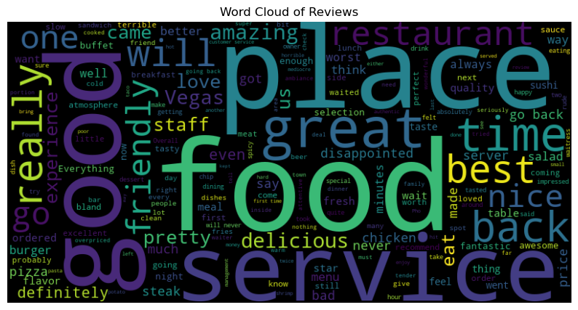
Result
The code generates a word cloud visualizing frequent words from restaurant reviews stored in data['Review']. By aggregating all text into combined_text and configuring dimensions and aesthetics (width, height, background_color), it creates a visual summary of prominent themes or sentiments expressed in the reviews, aiding in quick insight into customer feedback trends.

Slide 9
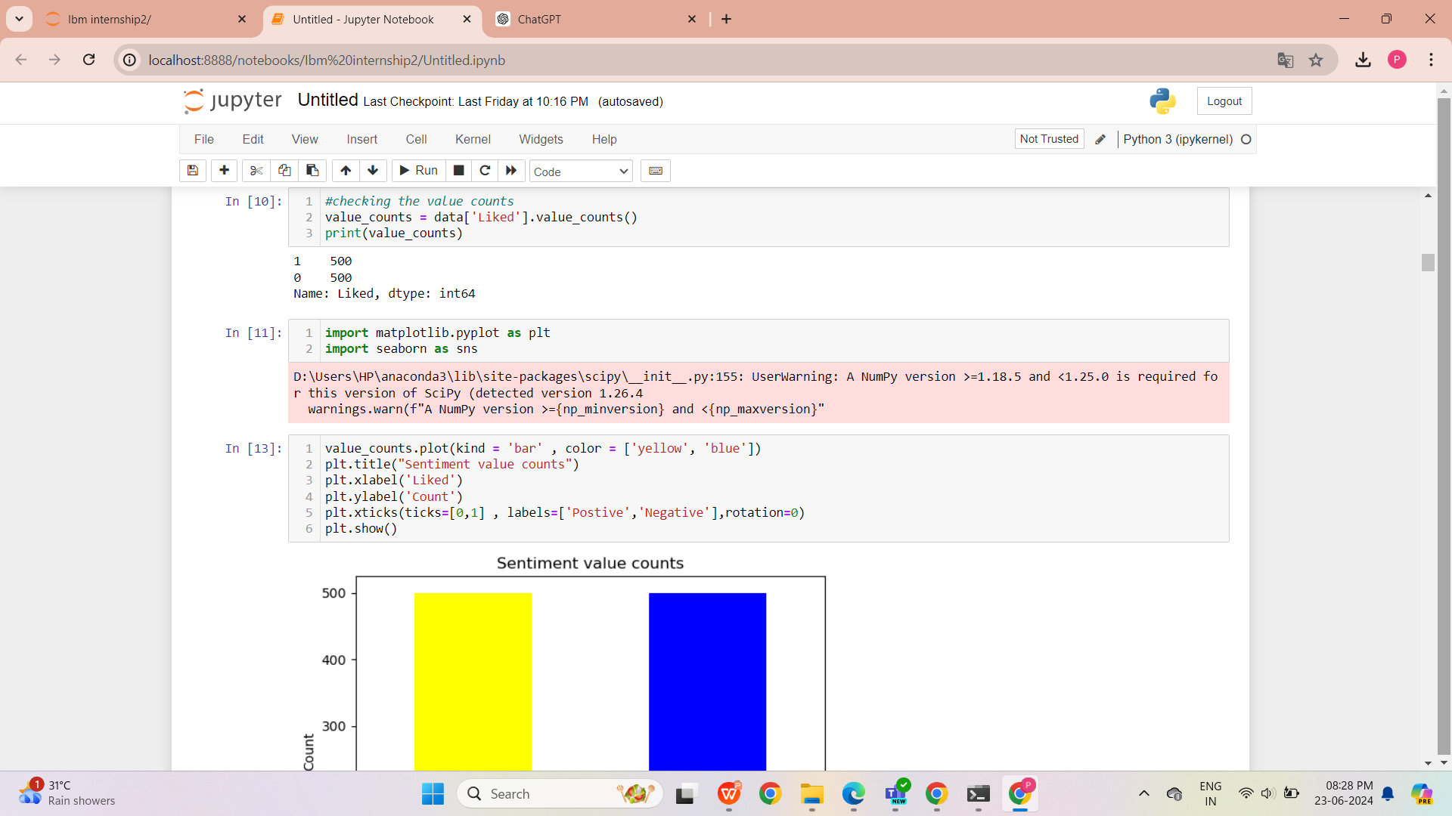
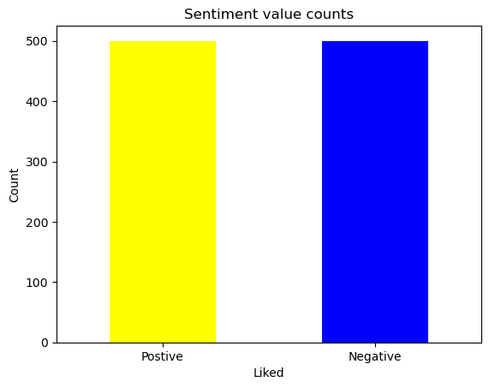
The provided code visualizes the distribution of sentiment labels ('Liked' column) using a bar plot. It assigns colors ('yellow' for positive and 'blue' for negative) to distinguish between sentiment categories. The plot includes clear labels and titles ('Sentiment value counts', 'Liked', 'Count') to enhance readability and understanding of the sentiment distribution in the dataset.

Slide 10
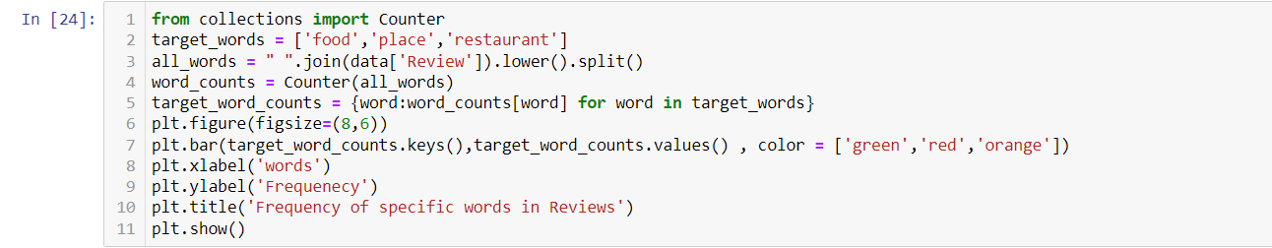
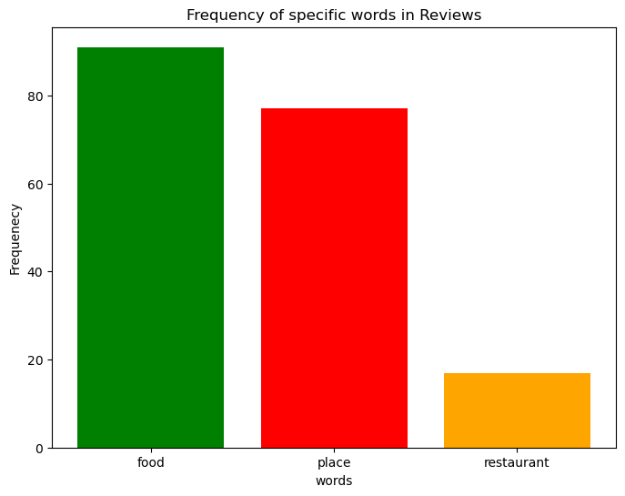
This code analyzes the frequency of specific words ('food', 'place', 'restaurant') within restaurant reviews from the dataset. It utilizes Python's Counter from the collections module to count occurrences of all words after converting them to lowercase and splitting them into a list. The resulting bar plot visualizes the frequency of each target word, helping to understand their prominence and relevance in customer reviews of the restaurant, providing insights into common topics or aspects mentioned.

Slide 11
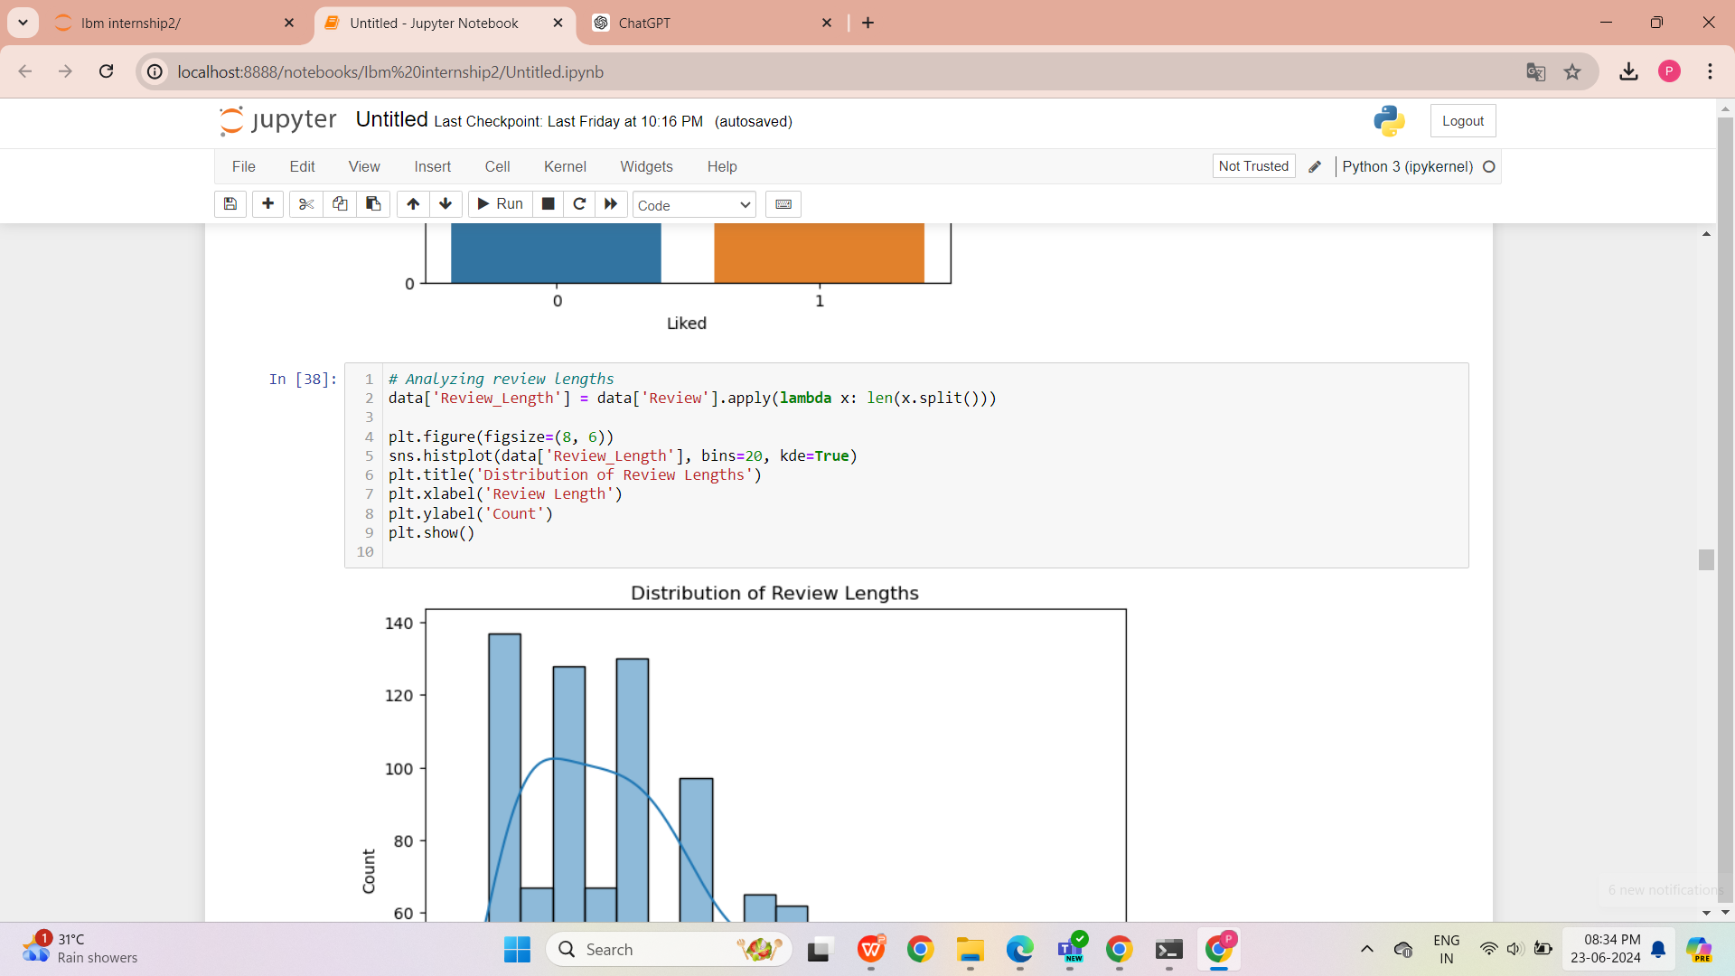
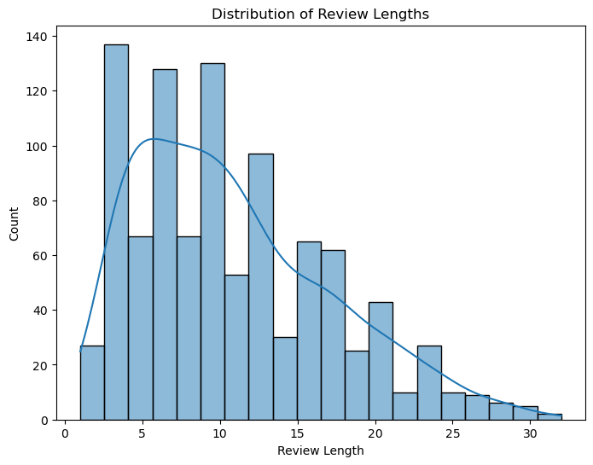
This code calculates and visualizes the distribution of review lengths in the dataset. It adds a new column Review_Length to data, capturing the number of words in each review using a lambda function and split() method. The resulting histogram plot, created with seaborn (sns), displays the distribution of review lengths across 20 bins, including a kernel density estimate (KDE), providing insights into the typical length and variation of reviews about the restaurant.

Slide 12
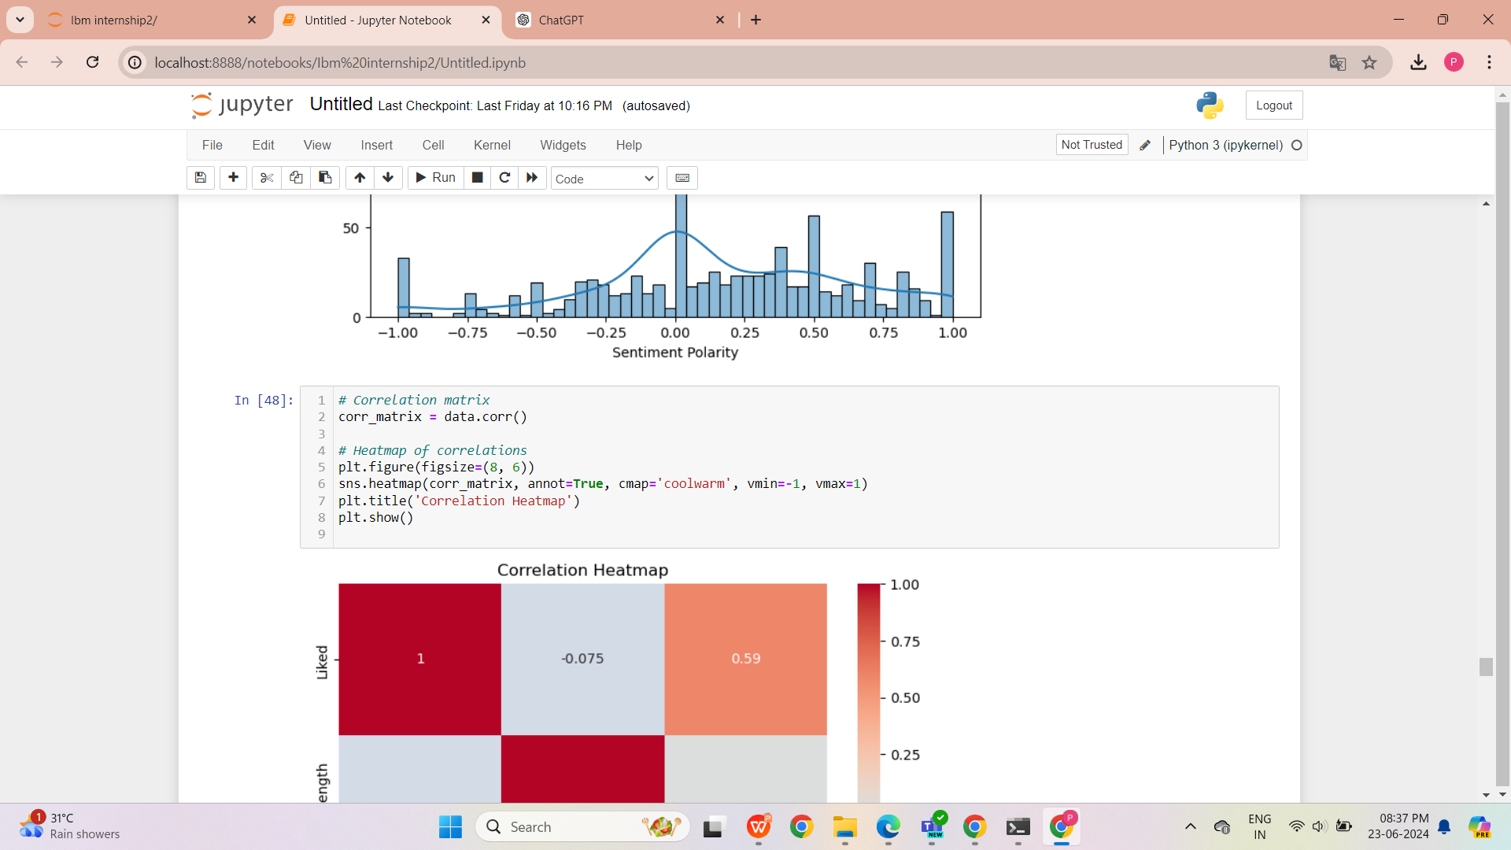
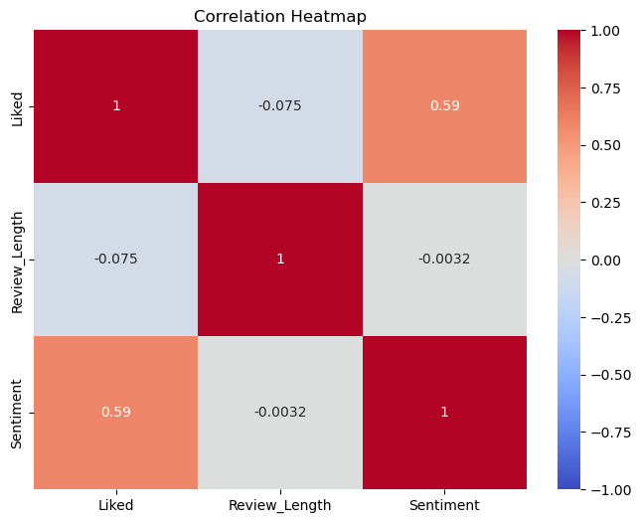
The code generates a heatmap to visualize the correlation matrix (corr_matrix) of numerical variables in the data dataframe. Using the sns.heatmap() function with annotations (annot=True), it provides a quick overview of the strength and direction of correlations between features, aiding in understanding relationships such as those between review sentiment ('Liked') and other numeric attributes like review length.

Slide 13
Conclusion
In conclusion, developing a sentiment analysis model for restaurant reviews involves transforming textual feedback into numerical representations, selecting and training a suitable model, evaluating its performance, and deploying it for practical use. This process enables automated analysis of customer sentiment, providing valuable insights to restaurant management for enhancing customer experience and satisfaction.

Slide 14
Future scope
The development of sentiment analysis models for restaurant reviews presents several promising future directions and opportunities:
Fine-tuning Models: Experiment with advanced pre-trained models like BERT or RoBERTa for improved accuracy.
Aspect-Based Analysis: Extend the model to identify and analyze specific aspects (e.g., food, service) within reviews.
Entity Recognition: Integrate named entity recognition (NER) to identify and classify entities mentioned in reviews (e.g., dishes, staff).
Negation and Context Handling: Improve the model's ability to understand negation and context within reviews.
Multilingual Support: Develop capabilities to handle reviews in multiple languages.
Fine-Grained Analysis: Consider more detailed sentiment scales beyond just positive/negative.
User-Item Interaction: Incorporate user preferences and behavior to personalize sentiment analysis.
Real-Time Analysis: Enable real-time sentiment analysis for prompt insights and responses.
Feedback Summarization: Develop techniques to summarize large volumes of reviews for actionable insights.
Business Metrics Integration: Link sentiment analysis results with business metrics for comprehensive insights.
Interactive Dashboards: Create user-friendly visualizations and dashboards for easy interpretation of sentiment data.
Sentiment Transfer Learning: Transfer sentiment knowledge across related domains like hotels or cafes.
Ethical Considerations: Address ethical implications such as bias detection and fairness in analysis.
These future avenues not only aim to improve the accuracy and granularity of sentiment analysis models but also to broaden their application scope in enhancing customer satisfaction, operational efficiency, and strategic decision-making for restaurants and hospitality businesses.

Slide 15
References
References for a sentiment analysis project focusing on restaurant reviews can include online resources, and relevant software documentation. Here are some examples of potential references you could cite:
Scikit-learn Documentation: https://scikit-learn.org/stable/documentation.html
NLTK (Natural Language Toolkit) Documentation: https://www.nltk.org/
Kaggle: https://www.kaggle.com/

Slide 16
THANK YOU

